Slide 1

Safe Road Users, Safe Vehicles and Safe Roads
February 23, 2023

Slide 2












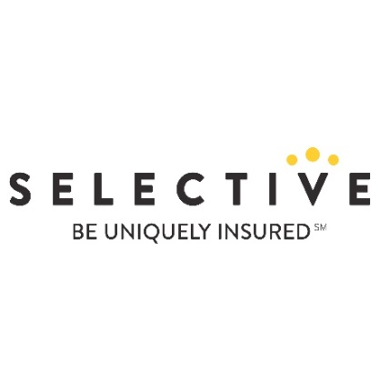










Who is Advocates: Our Board
Joan Claybrook, President Emeritus, Public Citizen, and former Administrator, National Highway Traffic Safety Administration
R. David Pittle, Product Safety and Regulatory Consultant, and former Commissioner, Consumer Product Safety Commission

Slide 3
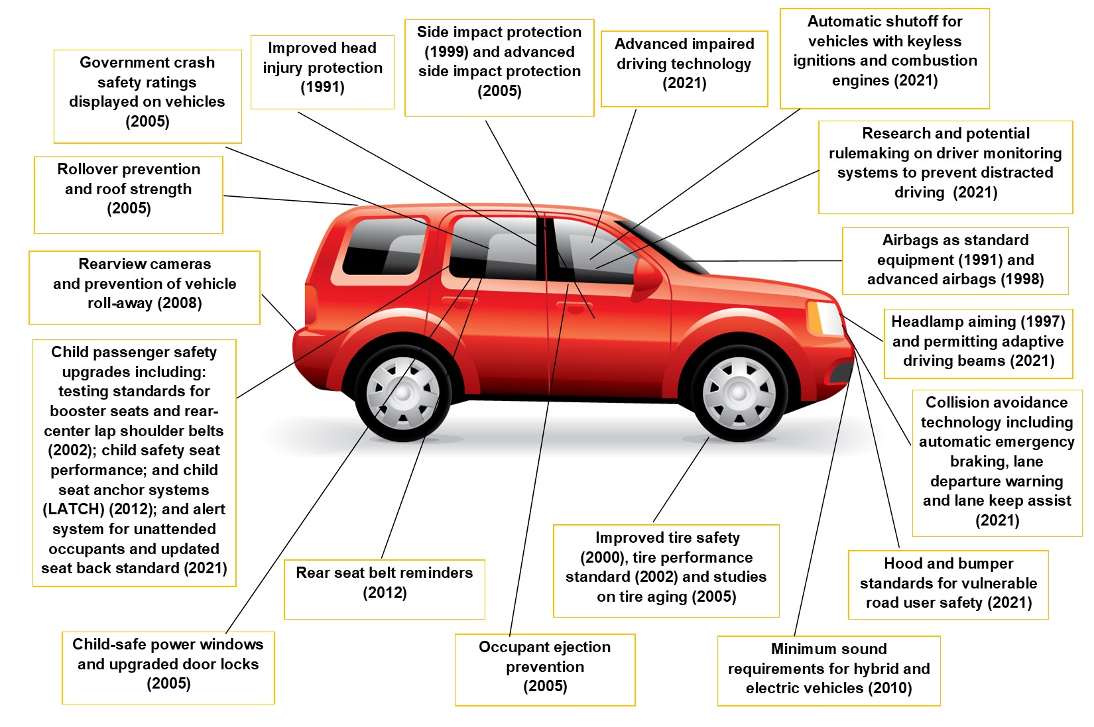
Advocates: Our Accomplishments

Slide 4
Status of Traffic Safety is Dire
Human Toll:
115 people killed on our roads every day
2022 : 31,785 people killed in the first 9 months
2021: 42,915 people killed - 10.5% increase
2020: 38,824 people killed - 21% increase
Financial Toll:
Over $1 trillion in total costs to society
“Crash tax” of $1,035 on every person living in the U.S.
Crashes alone cost employers $72.2 billion (2018)

Slide 5
Advocates: Our Approach
Advocates’ Mission
Safe Road Users
Safe Vehicles
Safe Roads
A Comprehensive Approach
State Legislation
Federal Legislation
Federal Regulation
Advocates’ Programs

Slide 6

Emphasizes Advocates’ Comprehensive Approach
Identifies Solutions
Federal:
Advancing proven vehicle safety technology
Funding for roadway infrastructure safety upgrades
State
Adoption of 16 critical traffic safety laws
Issues: distracted and impaired driving, occupant protection, child passenger safety, motorcycle rider safety, novice teen and young adult drivers and automated enforcement
Messaging
We know the issues. There are proven solutions. We need ACTION.
Notes:
Ban on distracting viewing - in 2024 when NHTSA releases determinations for 405 incentive grants.
This was a bipartisan measure that Advocates worked with Allstate to add to the Section 405 incentive grants for distracted driving (Krishnamoorthi (D-IL)/Gallagher (R-WI)) and to improve transparency in the determinations for the awards.

Slide 7
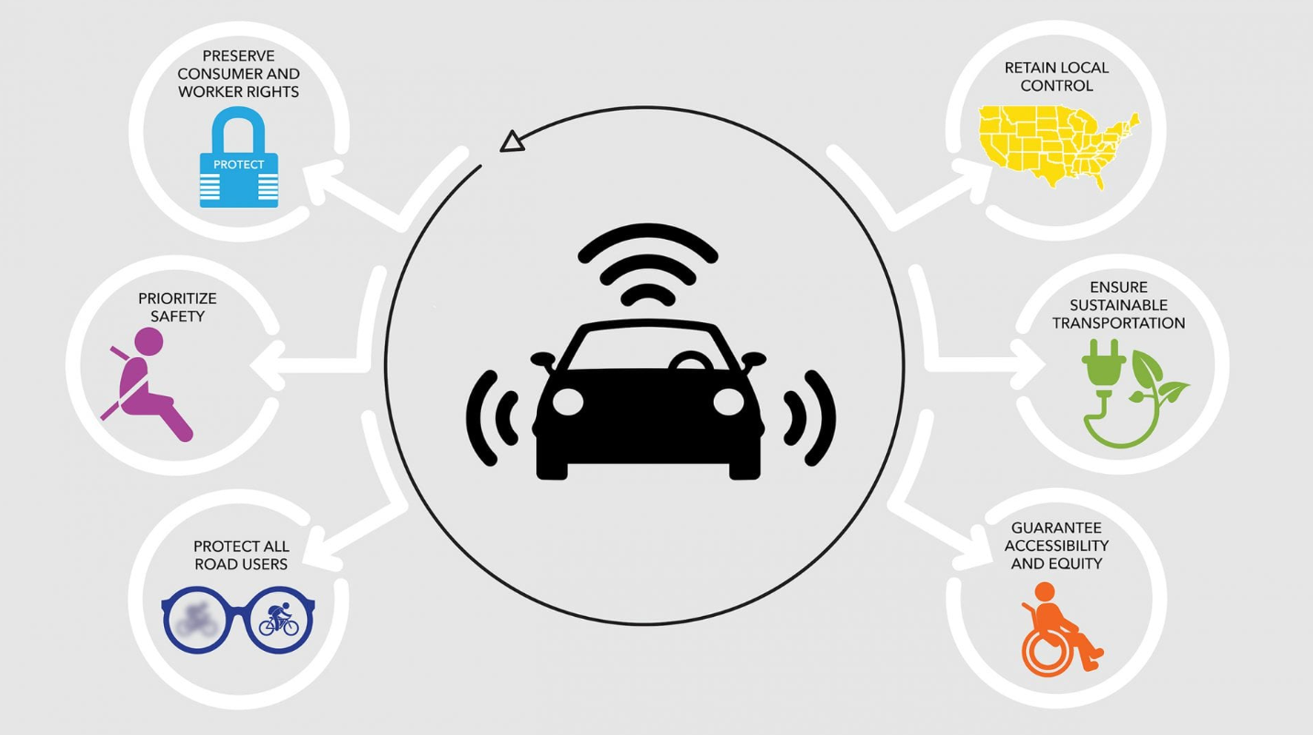
Looking Forward - Evolving Issues
Automated vehicles (AVs) and Automated driving systems (ADS)
Marijuana/Cannabis and Polyuse Impaired Driving
Vulnerable Road User (VRU) Safety (Pedestrians, bicyclists, wheelchair users, motorcycle riders, micromobility riders, roadside first responders, road construction workers)
Priority Countermeasures:
Advanced impaired driving prevention technology
Accelerated research to determine a causal link
Standard for cannabis impaired driving
Verified roadside testing technology
State laws: broadening open container, extending zero tolerance for under age 21 and lowering BAC limits to .05%
Priority Countermeasures:
State traffic safety laws to prohibit deadly driving (speeding, distracted, impaired)
Curbing speed/protecting VRUs – infrastructure upgrades, automated enforcement, intelligent speed assist
Automatic emergency braking: required to detect and respond to all people and objects in the roadway, at all speeds, in light and dark lighting conditions
Priority Countermeasures:
AV Tenets
Notes:
AVs:
Our concerns with the past AV bills:
they allow tens of thousands of AVs to be exempt from federal safety standards in the absence of new regulations on ADAS or AV tech and related issues like cybersecurity;
they do not require minimum safety regulations for the ADAS and ADS systems by a date certain;
they preempt the ability of states and localities to protect their citizens even in the absence of comprehensive federal standards and regulations;
they fail to require essential data and information be provided to consumers, regulators and investigators, among other problems; and,
they fail to ensure safeguards are in place to realize potential societal benefits (safety, accessibility, mobility, equity, environmental) while minimizing known and foreseeable issues that impact safety, the workforce and the identified desirable outcomes.

Slide 8

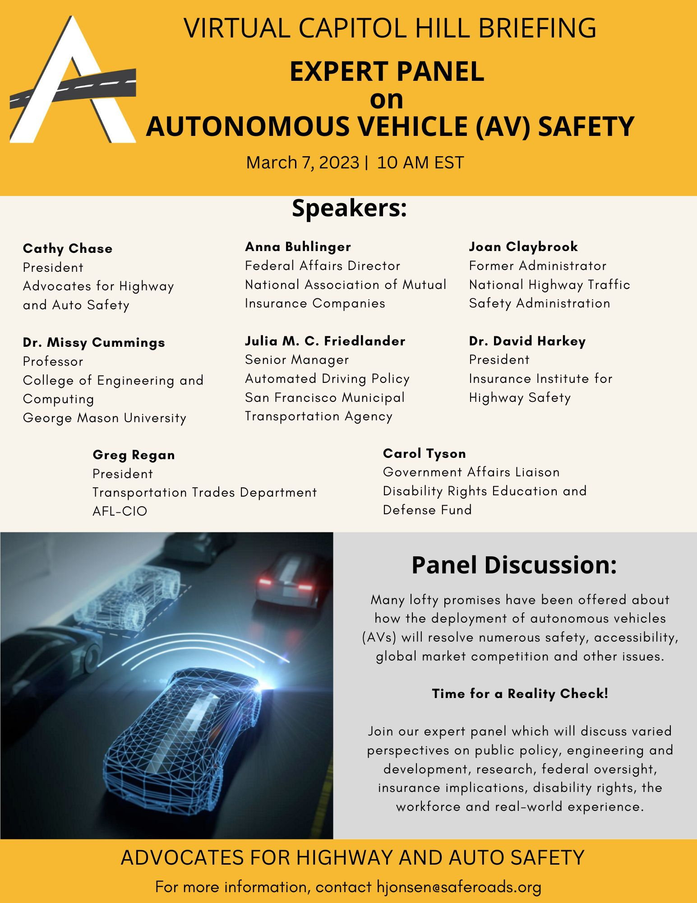

Looking Forward – AV Briefing March 7
Notes:
AVs:
Our concerns with the past AV bills:
they allow tens of thousands of AVs to be exempt from federal safety standards in the absence of new regulations on ADAS or AV tech and related issues like cybersecurity;
they do not require minimum safety regulations for the ADAS and ADS systems by a date certain;
they preempt the ability of states and localities to protect their citizens even in the absence of comprehensive federal standards and regulations;
they fail to require essential data and information be provided to consumers, regulators and investigators, among other problems; and,
they fail to ensure safeguards are in place to realize potential societal benefits (safety, accessibility, mobility, equity, environmental) while minimizing known and foreseeable issues that impact safety, the workforce and the identified desirable outcomes.

Slide 9
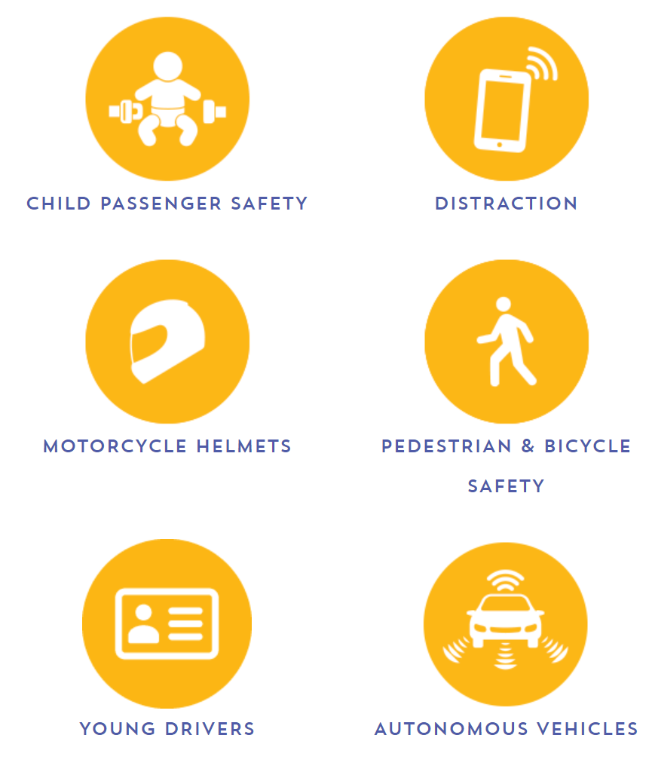
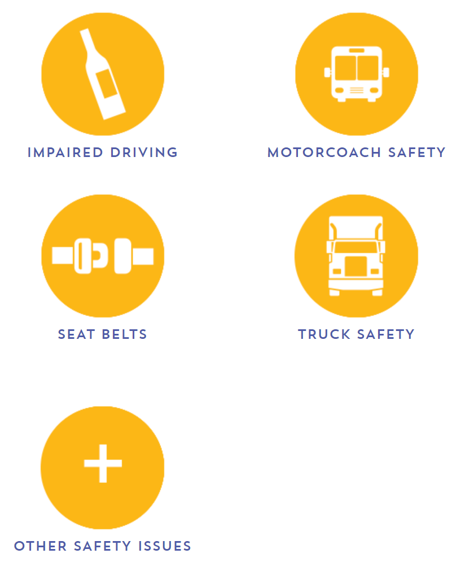

Cathy Chase, President
cchase@saferoads.org
Tara Gill, Sr. Director State and Federal Govt. Rlns.
tgill@saferoads.org
Latest News, Information and Resources at:
www.saferoads.org
SPEED
Notes:
AVs:
Our concerns with the past AV bills:
they allow tens of thousands of AVs to be exempt from federal safety standards in the absence of new regulations on ADAS or AV tech and related issues like cybersecurity;
they do not require minimum safety regulations for the ADAS and ADS systems by a date certain;
they preempt the ability of states and localities to protect their citizens even in the absence of comprehensive federal standards and regulations;
they fail to require essential data and information be provided to consumers, regulators and investigators, among other problems; and,
they fail to ensure safeguards are in place to realize potential societal benefits (safety, accessibility, mobility, equity, environmental) while minimizing known and foreseeable issues that impact safety, the workforce and the identified desirable outcomes.

